Slide 1
McBSP
C6657 Workshop
T TO
Technical Training
Organization
Copyright © 2012 Texas Instruments. All rights reserved.

Slide 2
Outline
McBSP Overview (data Ch on DSK)
T TO
Technical Training
Organization

Slide 3
McBSP Block Diagram
CPU
Expand (optional)
Compress (optional)
D
R
R
R
B
R
RSR
DR
32
I n t e r n a l
B u s
D
X
R
XSR
DX
CLKR
CLKX
EDMA
RCR
SRGR
McBSP Control
Registers
SPCR
CLKS
XCR
PCR
FSR
FSX
McBSP = Multi-channel Buffered Serial Port
DRR = Data Rcv Reg, DXR = Data Xmt Reg, RBR = Rcv Buffer Reg
RSR = Rcv Shift Reg, XSR = Xmt Shift Reg
T TO
Technical Training
Organization
Let’s look at some basic definitions…

Slide 4
Basic Definitions - Bit, Word
CLK
FS
D
a1
a0
b7
b6
b5
b4
b3
b2
b1
b0
Word
Bit
“Bit” - one data bit per SP clock period
“Word” or “channel” contains #bits specified by WDLEN1 (8, 12, 16, 20, 24, 32)
Serial Port
SP Ctrl (SPCR)
Rcv Ctrl (RCR)
RWDLEN1
Xmt Ctrl (XCR)
Rate (SRGR)
Pin Ctrl (PCR)
XWDLEN1

Slide 5
Basic Definitions - Frame
FS
D
w6
w7
w0
w1
w2
w3
w4
w5
w6
w7
Frame
Word
“Frame” - contains one or multiple words
FRLEN1 specifies #words per frame (1-128)
Serial Port
SP Ctrl (SPCR)
Rcv Ctrl (RCR)
RFRLEN1
RWDLEN1
Xmt Ctrl (XCR)
Rate (SRGR)
Pin Ctrl (PCR)
XFRLEN1
XWDLEN1

Slide 6
EDMA Sync Events from McBSP
EDMA
DRR
RBR
RSR
C O D E C
REVT1
RRDY=1
“Ready to Read”
DXR
XSR
XEVT1
XRDY=1
“Ready to Write”
Receive Event (REVT1)
When value reaches DRR, sync event sent to EDMA.
This can be used to trigger an EDMA transfer.
Serial Port
Transmit Event (XEVT1)
Sent to EDMA when DXR is emptied (and ready to receive another value)
SP Ctrl (SPCR)
Rcv Ctrl (RCR)
Xmt Ctrl (XCR)
Rate (SRGR)
Pin Ctrl (PCR)
XRDY
RRDY

Slide 7
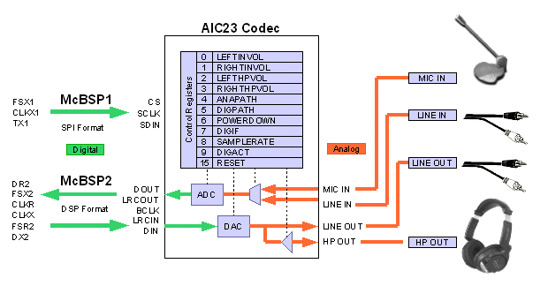
AIC23 Audio CODEC Example
Control
Channel
2-wire
SPI
C6657: I2C
Data
Channel (Stereo)
Right Justified
Left Justified
I2S
DSP Mode
C6657 : McBSP1
24-bit resolution (90db SNR ADC, 100db SNR DAC)
Multiple Digital transfer widths (16-bits, 20-bits, 24-bits, 32-bits)
Programmable frequency (8K, 16K, 24K, 32K, 44.1K, 48K, 96K)
AIC23 has two serial ports:
Control: reads/writes AIC23’s control registers
Data: Bidirectional pin to transfer data from A/D and to D/A converters
T TO
Technical Training
Organization

Slide 8
SCR & McBSP
M
S
Master
Slave
32
EDMA3
TCP2
SCR = Switched Central Resource
TC0
VCP2
CC
TC1
TC2
McBSP PCI Utopia
L1P
TC3
C64x+ MegaModule
L1P Mem Ctrl
PERIPH
EMAC HPI PCI
DDR2
AET
EMIF
M
S
Cfg
L2 Mem Ctrl
D
D
L2
IDMA
CPU
S
S
SRIO
M
M
L
L
S
M
External Mem Cntl
L1D Mem Ctrl
128
M
S
M
PERIPH =
All peripheral’s
Cfg registers
128
L1D
S
DATA
SCR
32
McBSP is a slave on the DATA SCR
DRR/DXR (data) registers are accessed via the DATA SCR
McBSP configuration registers are accessed via the CFG SCR
CFG
SCR
Notes:
This is somewhat of a simplification of the SCRs and megamodule diagrams in the datasheet.

Slide 9
TTO
Technical Training
Organization
ti
T TO
Technical Training
Organization

